Slide 1
Recap: Correlations
Identifies association between variables
Common measures:
Pearson’s r: Linear correlation
Spearman’s ρ: Rank correlation
Kendall’s τ: Like Spearman’s
Cohen’s κ: Agreement between categorical (nominal) variables
Considerations:
Sign of coefficient indicates direction of association
Report coefficient (strength) and p-value (significance)
Sensitivities to range, outliers, number of observations and linearity
Correlation does not imply causation

Slide 2
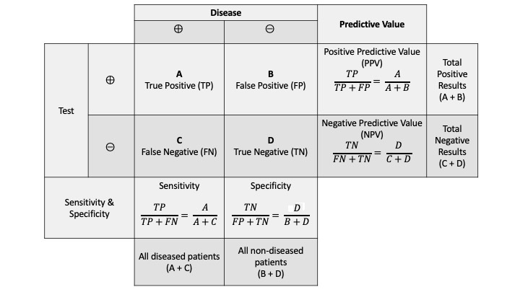
Recap: Binary classification
Sensitivity: Proportion of true positives out of positives
Specificity: Proportion of true negatives out of negatives
Usually a trade off of sensitivity vs specificity
ROC curves provide a summary of a test across a range of thresholds

Slide 3
Recap: Comparisons continuous data
Means independent (two group):
Parametric: t-test
Non-parametric: Mann-Whitney (Wilcoxon)
Means paired (two group):
Parametric: paired t-test
Non-parametric: Wilcoxon signed rank
Variance:
Parametric: F test
Mainly comes up in ANOVA for this course
Means (>= 2 group)
Parametric: ANOVA
Non-parametric: Kruskall-Wallis

Slide 4
Recap: Comparisons other
Proportions:
𝜒²: When contingency table >= 2x2. Continuity correction should be use when n is small.
Fisher’s exact test: Only applies to 2x2 contingency table. Should be used when n<=5.
Multiple testing:
When performing multiple comparisons a correction is needed
Simplest is Bonferroni which divides the required p-value by number of test i.e. for 5 tests at a significance of 0.05, each test would need p < 0.01 for significance
More powerful alternatives to exist but would be appropriate to consult statistician

Slide 5
Intermediate Statistics
Module 7

Slide 6
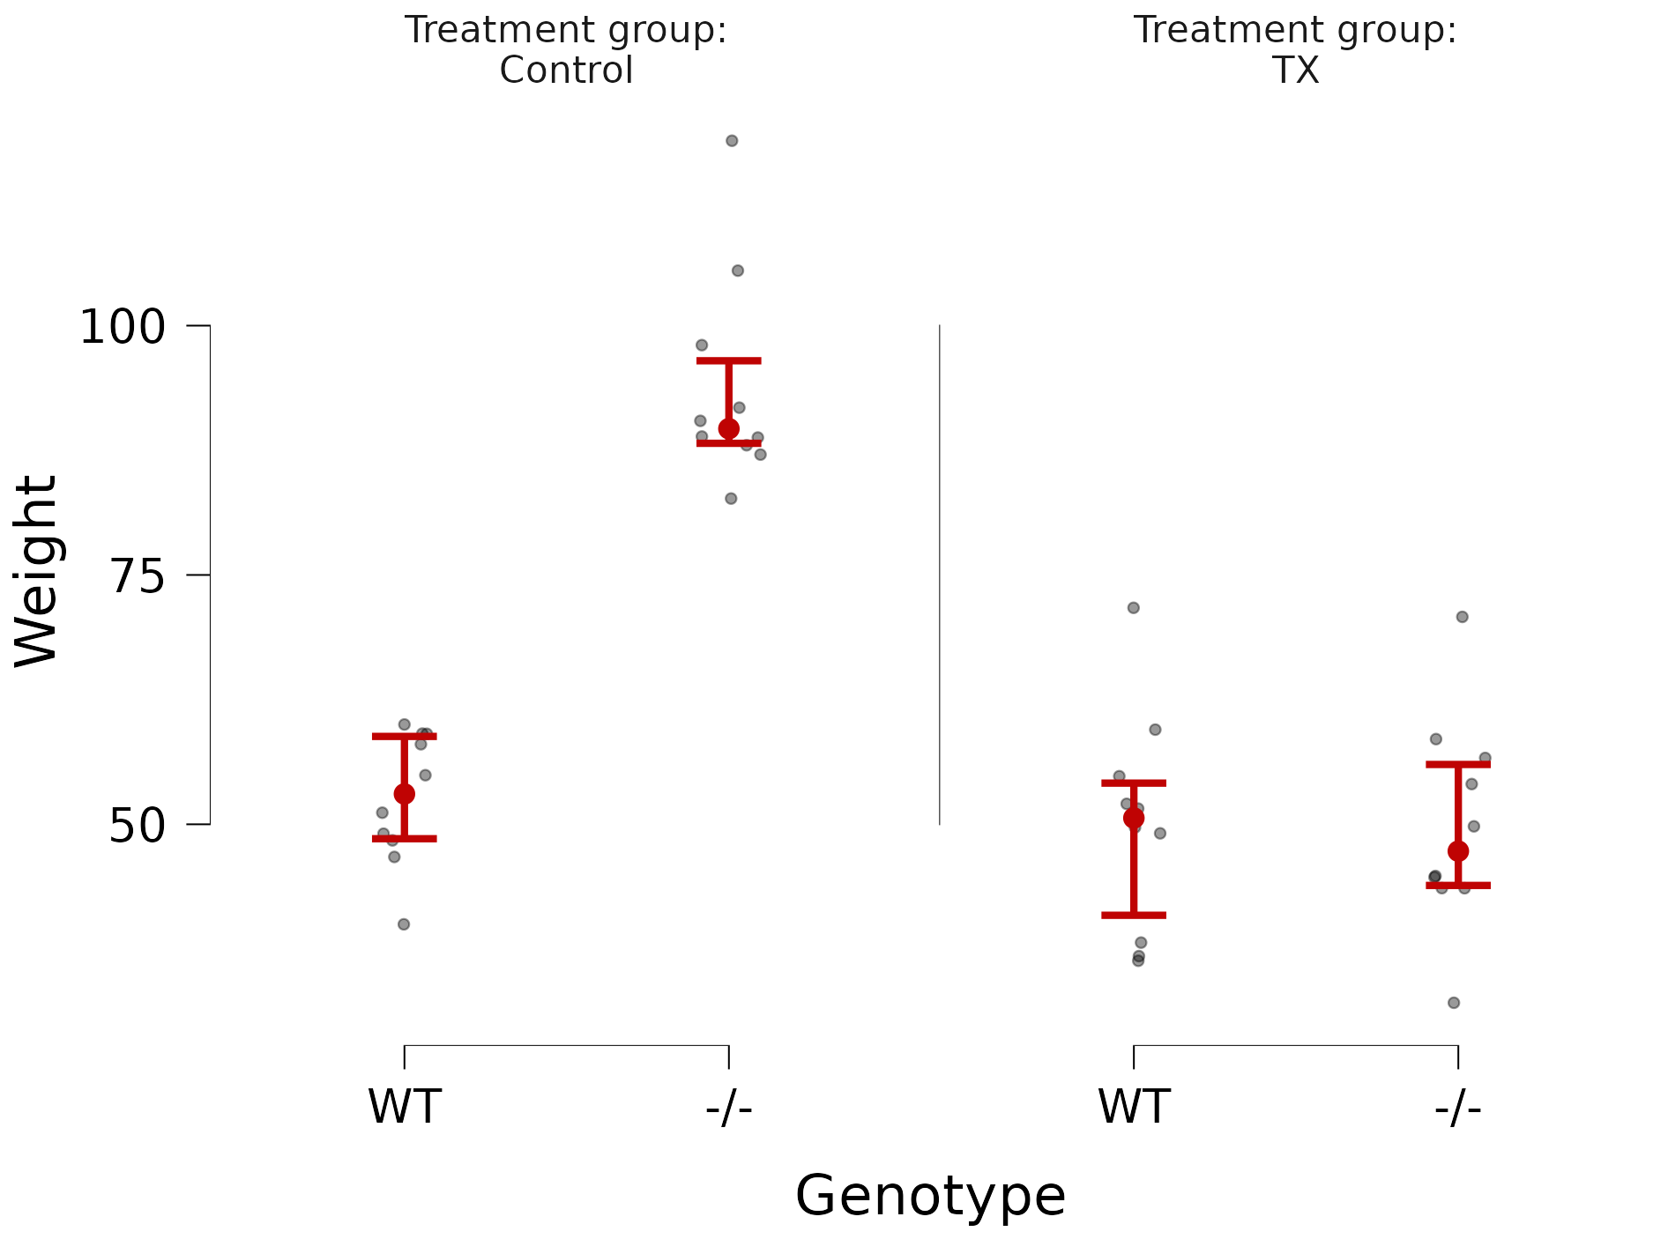
Multiple variable testing
Example : Two groups: Control and TX, each with 10 mice (5 WT, 5 -/-). Weight was measured once in each mouse at time X.
Open mouse_anova.csv in JASP

Slide 7
Multiple variable testing
Model could be a lot more complex if you had a larger sample:
Two groups: Control and TX treated, each with 30 mice (10 WT, 10 +/-, 10 -/-), and the mice are of both sexes, half and half.
Weight was measured at baseline and after treatment, at time X.
Continuous outcome of interest: weight at time X.
Categorical predictor variables:
Treatment (3)
Genotype (3)
Sex (2)
Continuous predictor variables:
Weight at baseline
Open mouse_linear_regression.csv in JASP

Slide 8
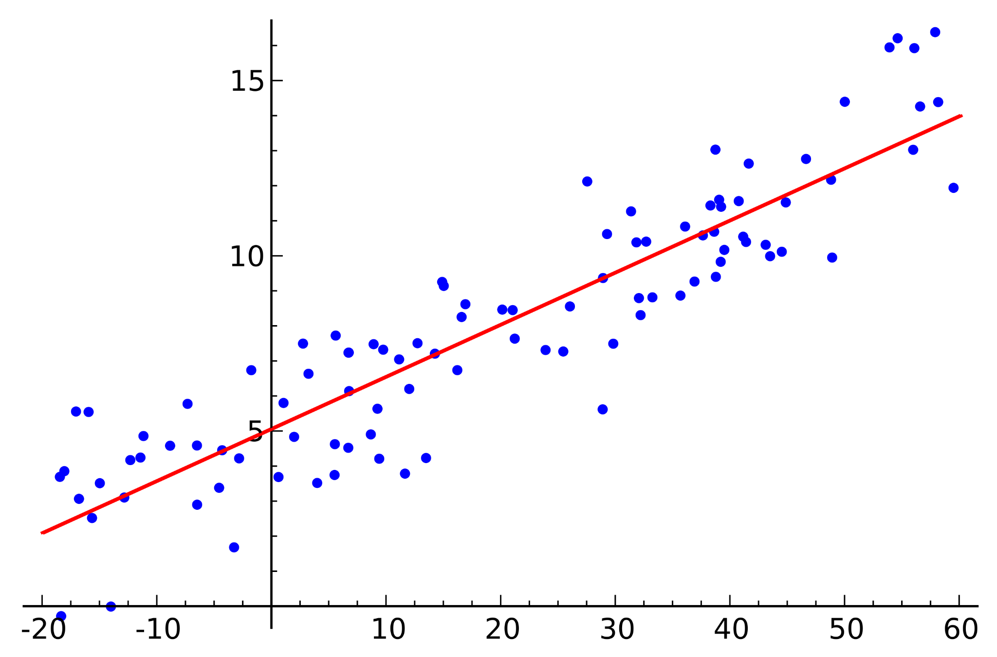
Regression - Univariable
One independent (X) to predict values of the dependent variable (Y)
Assumes a linear relationship between X and Y
Assumes normality of residuals
What is a residual?
https://en.wikipedia.org/wiki/Linear_regression

Slide 9
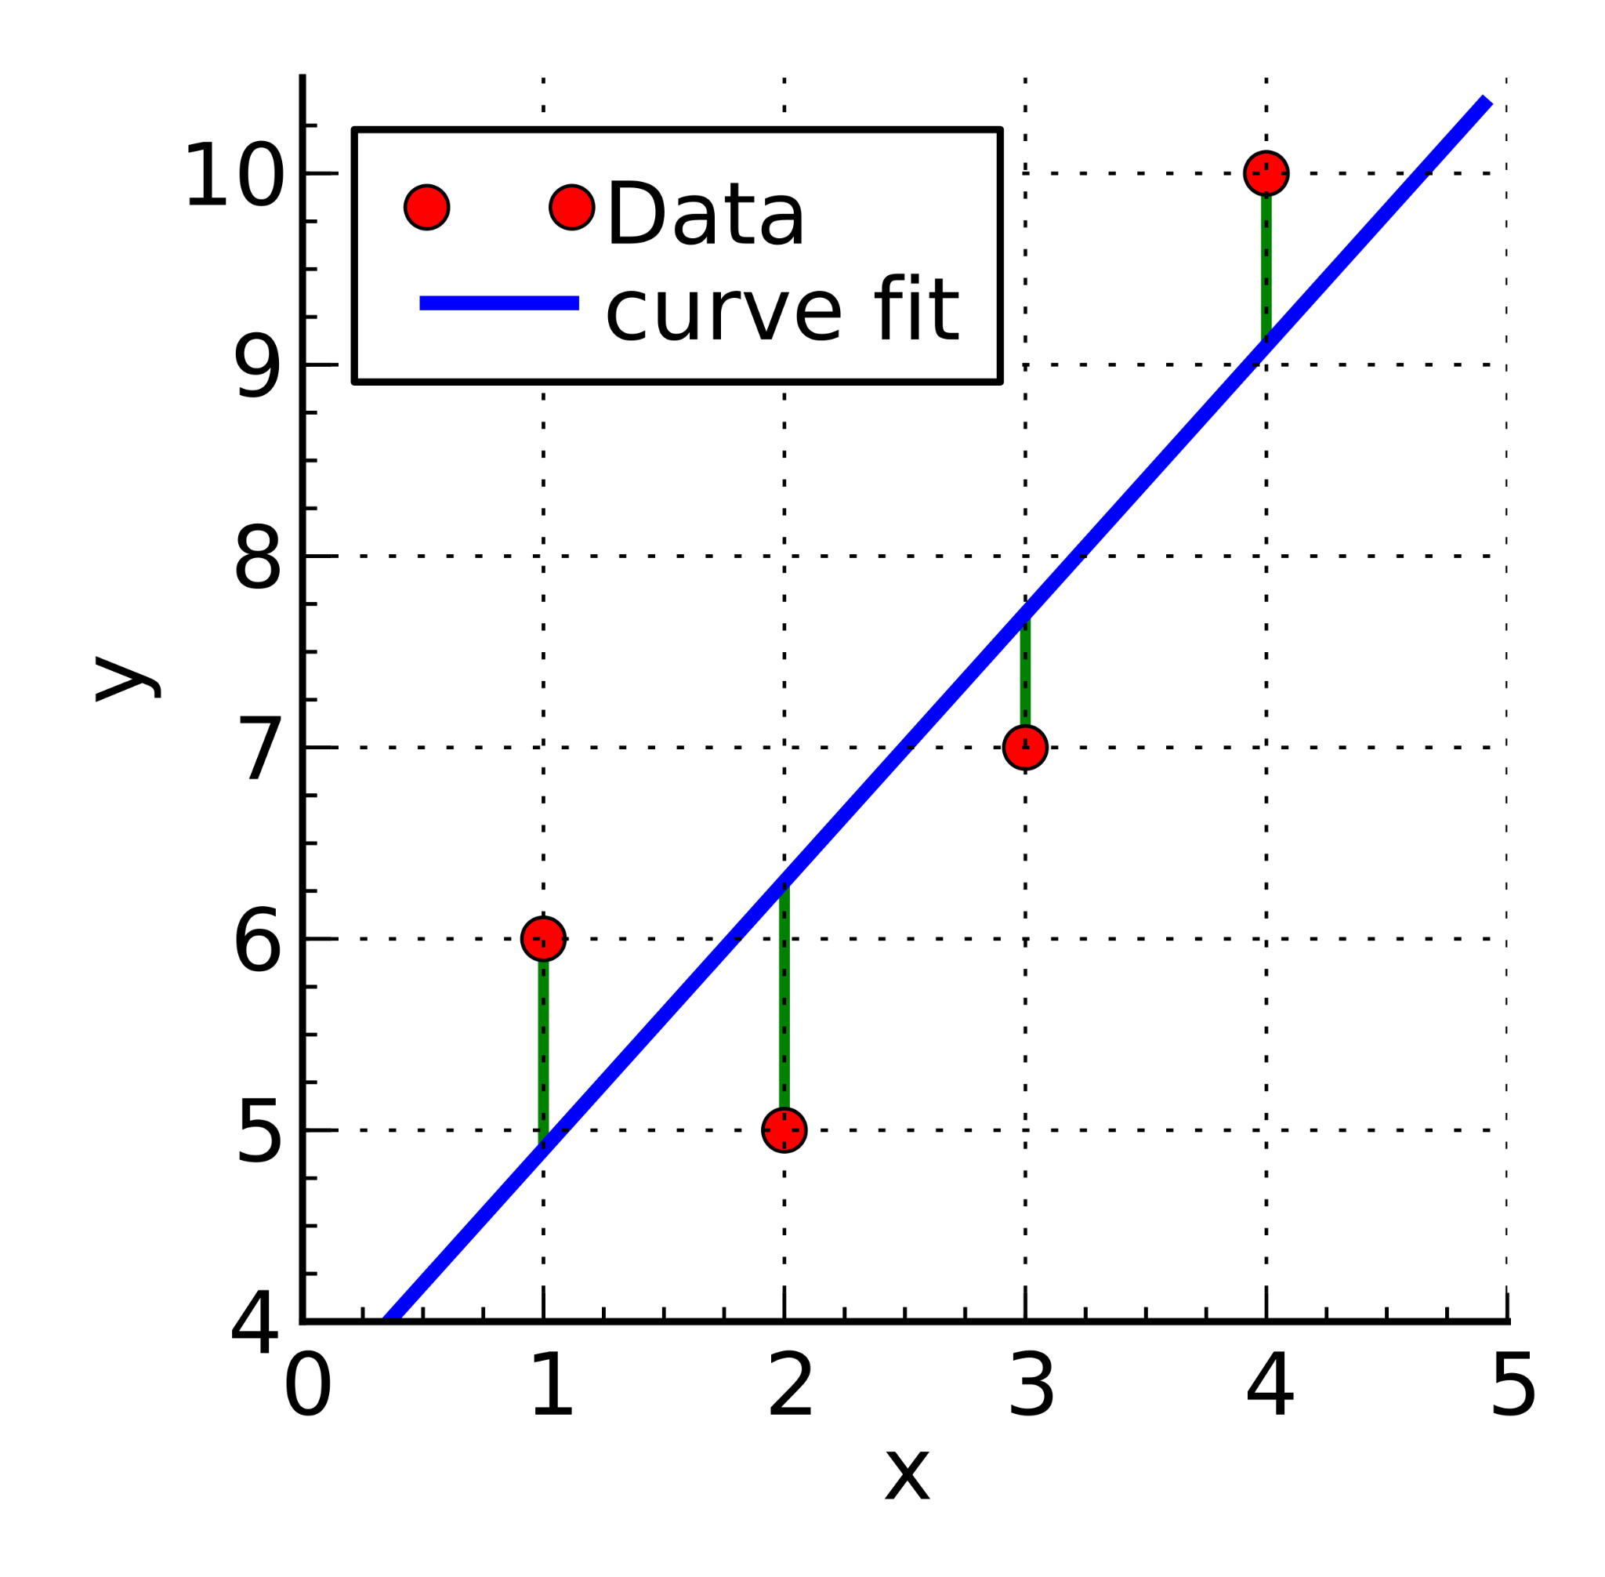
Residuals in regression
The sum of deviation of data points from line of best fit
The goal of any line of best fit is to reduce the sum of squared residuals
https://en.wikipedia.org/wiki/Linear_regression

Slide 10
Regression assumptions
Linear relationship between outcome (Y) and predictor (X)
The residuals are Normally distributed
Homoscedasticity (aka similar variance in error across predictors)
Plot of residuals by predicted values
In multivariable linear regression
Minimal collinearity amongst predictor variables: Use Variance Inflation Factor (VIF) to detect (<2.5)

Slide 11
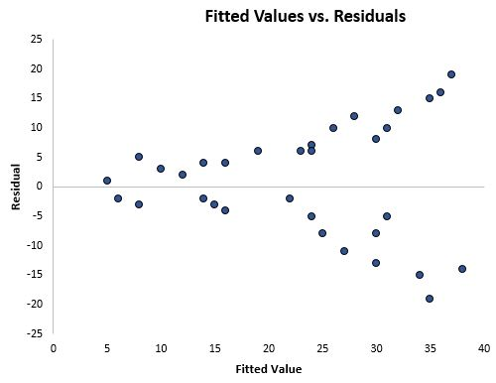
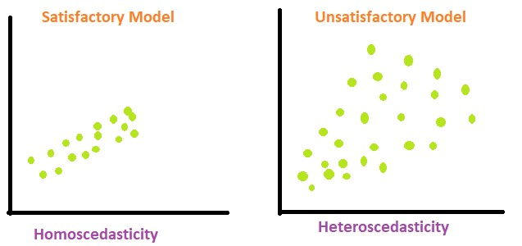
Homoscedasticity/Heteroscedasticity
https://www.geeksforgeeks.org/heteroscedasticity-in-regression-analysis/
https://www.statology.org/heteroscedasticity-regression/

Slide 12
Multivariable regression
Examine the combination of multiple effects on the outcome of interest - the response variable.
Outcomes:
Determine how well a set of variables model the response variable.
Determine which variables significantly impact the model.
Develop an equation which may be able to predict the response variable.

Slide 13
Multivariable regression
Things to consider:
How many variables are too many to include in your analysis?
Very general guideline is around 20 observations per variable.
Criteria for variable inclusion in your model
Literature
Specified p-value from univariable analysis
May not have to have a p-value <0.05
TAKE HOME MESSAGE: You must disclose the method you used in your manuscript.

Slide 14
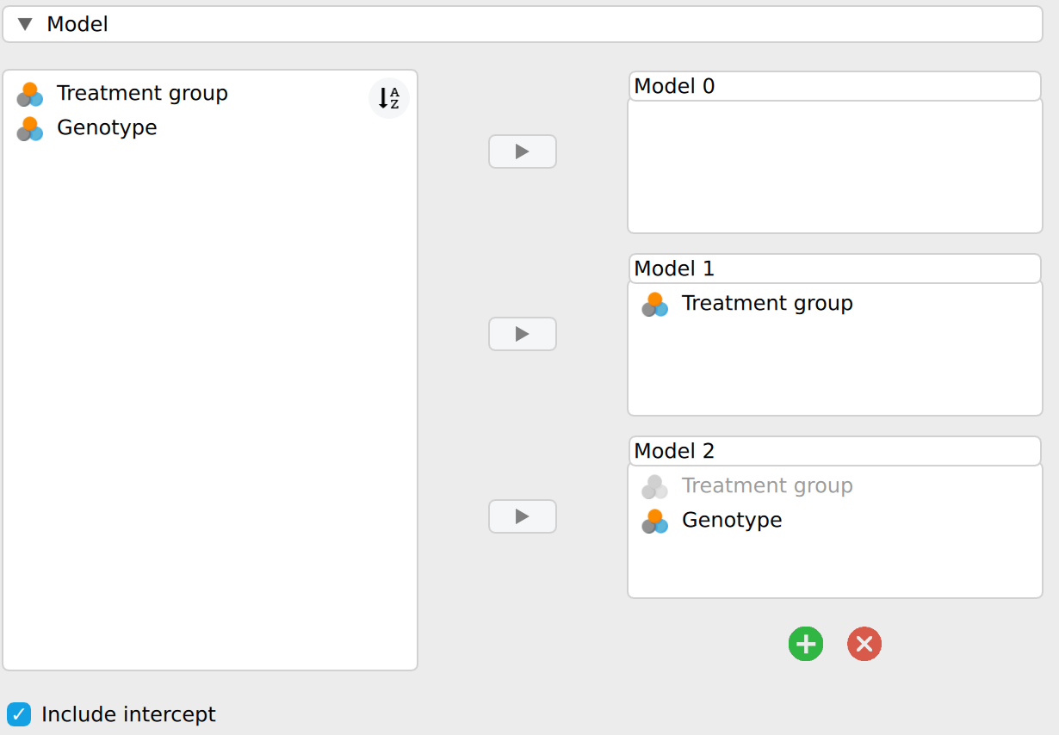
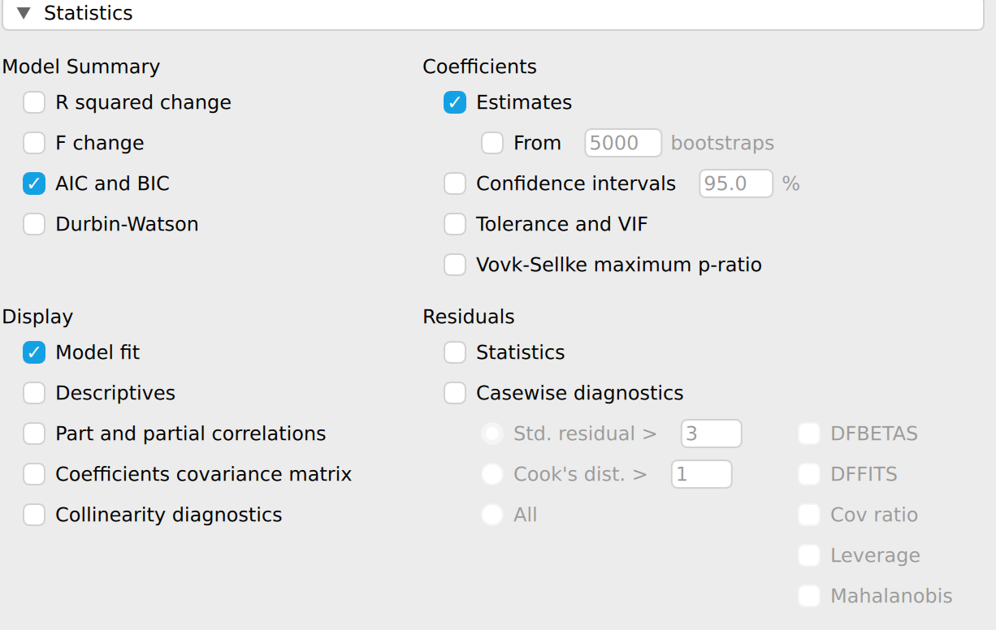
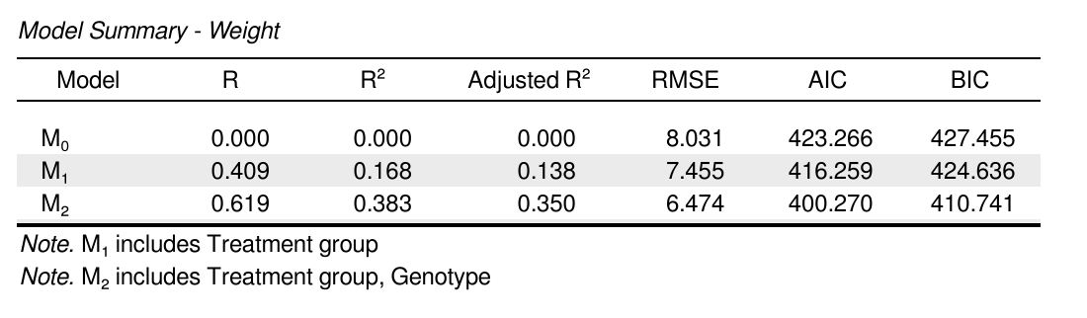
Multivariable regression - variable selection
AIC and BIC: The goal is to reduce these metrics by the removal of variables from your model.
Stepwise methods can be used to reduce a large number of independent variables to those that are likely to have a significant effect on the model.

Slide 15
Multivariable regression - variable selection
There is no ‘correct’ set of variables.
However, some models are suboptimal to others.
A number of considerations must be accounted for: face validity, historical context and background knowledge
It is best to consult a statistician at this point as there are a number of strategic decisions that have to be made which will influence which variables are selected.

Slide 16
Interactions
When a set of features have an effect when present together we refer to this as an interaction
Interaction effects can be caused by things like drugs that only work with a specific genotype
We saw interaction terms from the ANOVA and ANCOVA analysis
They can also be incorporated into a multivariable linear regression model

Slide 17
Multivariable regression exercise
Open file “Diabetes Full.xlsx” in JASP
Goal is to determine which set of variables best describe Y (dependent variable)
Which variables to include? Rationale?
Establish the absence of collinearity (strong association) between dependent variables
Adjust model
Check your assumptions

Slide 18
Logistic regression
When you have a continuous X against a categorical Y
Measures the change in proportion of various levels of X against the change of gradient in Y.
Useful in determining a predictive effect of a single variable.

Slide 19
Multivariable logistic regression
Using a number of variables to predict a categorical outcome
Uses essentially the same methodology as was described for Multivariable Regression

Slide 20
Non-linear regression
It is flawed to try to fit a straight line to non-linear data.
A variety of non-linear models can fit a data set to varying degrees
Some examples of non-linear equations include:
Polynomials (Quadratic, Cubic, Quartic, Quintic)
Sigmoid (Logistic, Gompertz)
Exponential Growth & Decay
Peak Models (Gaussian & Lorentzian)
Pharmacokinetic (Oral Dose, IV Bolus, Biexponential)
Enzyme Kinetics (Michaelis Menten)
Best to consult a statistician if you need these approaches.

Slide 21
Time to failure analysis
Commonly called Survival analysis
Principally three uses in human studies
Time to death from any cause
Overall Survival (OS)
Time to death from disease
Disease Specific Survival (DSS)
Time to progression or relapse
Progression Free or Relapse Free Survival (PFS or RFS)

Slide 22
Time to failure analysis
Two essential variables
Time
Start point -date (birth, presentation of symptoms, diagnosis)
End point (death, death from disease, disease progression, loss of follow-up)
Censor
Used when a subject has not encountered a pre-specified endpoint.

Slide 23
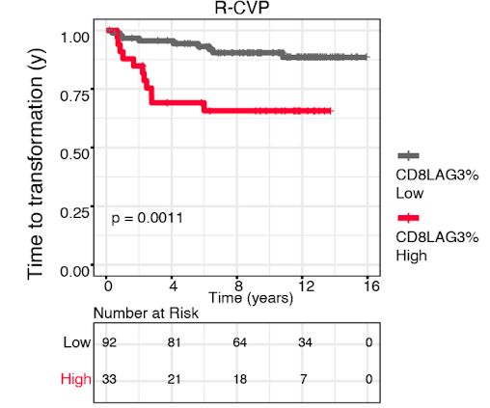
Time to failure analysis (univariable)
Kaplan-Meier curves are typically used when considering the effect of single variable i.e. sex, treatment, stage of tumour
Significant differences emerge immediately at the initiation of follow up and are assessed by use of the Log-Rank Statistic.

Slide 24
Time to failure analysis
Prognostic factors:
Negative - leads to an event faster
Positive - protects or delays a subject from an event
Many variables can be assessed simultaneously using a method known as the Cox-Proportional Hazards Model.
Uses the same approach as multivariable regression

Slide 25
Cox Proportional Hazards Model
Input variables:
Time
Censor
Variables (Research variable(s) and clinical covariates)
Goal - To determine which factors show ‘independent prognostic significance

Slide 26
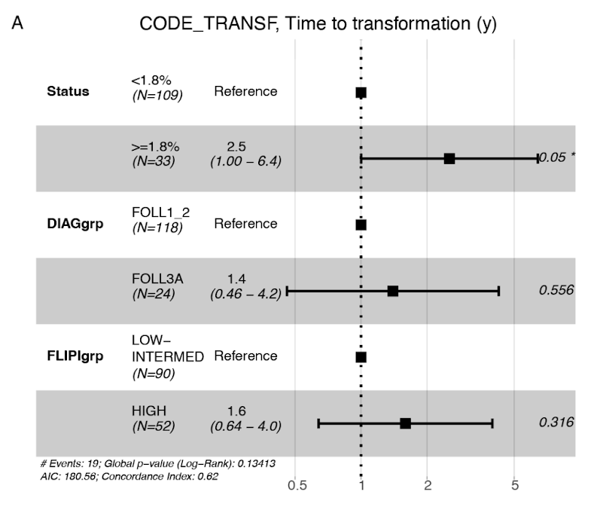
Forest plots
Not currently supported in JASP
Show the resultant risk ratios (aka Hazard Ratios) from the Cox Proportional Hazards Model
For each variable, the centre point represents the Risk Ratio and the lines on either side of the point represent the 95% confidence interval.
A risk ratio of 1 indicates no significant difference.
A risk ratio < 1 indicates a positive prognostic factor (slows time to event)
A risk ratio > 1 indicates a negative prognostic factor (speeds up time to event)

Slide 27
Survival analysis exercise
Univariable analysis to determine if Adjuvant Chemotherapy is effective in Pancreatic Ductal Adenocarcinoma
Multivariable analysis to determine which set of variable are independently prognostic in Pancreatic Ductal Adenocarcinoma

Slide 28
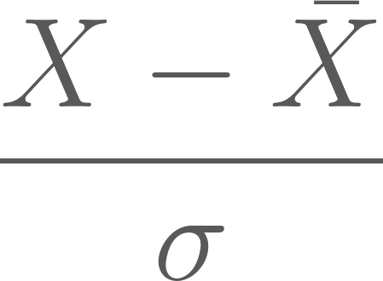
Standardising data (z-scores)
Useful when you have data on two different scales.
Computed as:
Where X is the row value, X-bar is mean of the column and sigma is the standard deviation for the column.
Can do this in JASP using Edit Data
Create a new column and name it
Select computed type - Compute with drag and drop
Add “zScores” and drag the variable inside the “zScores”

Slide 29
Missing data - types
Informative
Data are missing for a reason
May introduce systematic bias
Non-informative
Random in nature
Bias toward the null (generally)
Examples from your research?

Slide 30
Missing data - excluding
Most conservative - exclude sample
How many samples is too many to exclude?
Rule of thumb ~10% but you have to demonstrate that the excluded cases are not fundamentally different from the remaining cohort.

Slide 31
Missing data - Imputation
Not currently supported in JASP
A more liberal approach is to impute missing data.
Basically we guess the missing values
We hope to do it in a way that does not bias the results
Approaches
Randomly assign a value within the range of the existing data set.
Set to the mean
Multivariate Normal Imputation
Multivariate Singular Value Decomposition
Consult a statistician if you feel that your data needs imputation.

